Slide 1

Travel Arrangement and Appointment System
Arianne Bianca Papna
Erika Hidalgo
Roxanne Therese Luangco

Slide 2
Background of the Client
JMGTCC is a Philippine-based travel bureau engaged in international and local ticketing, hotel reservation, worldwide tour packages, domestic island tours, corporate travel plans, and customized travel arrangements. JMGTCC specializes in adventure and off-the-beaten path tourism and travel activities.
Client
Ms. Katherine Mayo JMGTCC General Manager

Slide 3
Project Overview
JMGTCC Travel Arrangement & Appointment System is a web application that caters JMGTCC Client's travel inquiries and appointments.
The application is accessible outside the internal network of JMGTCC for the company's clients and prospect clients.

Slide 4
Project Objectives
Short-Term Objectives
To improve the features or modules of the existing JMGTCC Booking & Reservation System
To add new features or modules to the existing system
To incorporate adequate security checklist and validations to system
Long-Term Objectives
To automate the company's manual Appointment processing for Visa Assistance
To consolidate all the JMGTCC Clients' travel inquiries and travel arrangements to a single system

Slide 5
Iteration 1
Deliverable
Arianne Bianca Papna
Updated Database design
Generated Models/CRUD for Appointment
Installed Date Picker for Appointment Form
Erika Hidalgo
Installed Advanced Yii 2.0 Template
Updated User Module
Generated Models/CRUD for Roles, User, Staff
Roxanne Therese Luangco
Generated Models/CRUD for Contact Number, Accommodation, Tour Deals, Hotels, Airlines, Travel Arrangement
Initially updated Travel Arrangement Form

Slide 6
Iteration 2
Deliverable
Arianne Bianca Papna
Updated Models/CRUD for Appointment, Generated Appointment Code
Fixed Email UI for Appointment Reference
Erika Hidalgo
Fixed User restrictions
Updated Maintenance Modules
Roxanne Therese Luangco
Updated Travel / Tour Arrangement
Fixed Email UI for Arrangement Requests

Slide 7


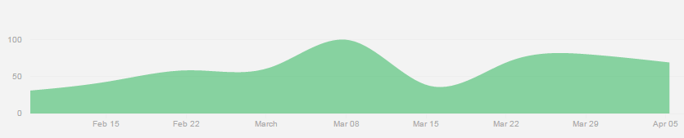
Member Contributions

Slide 8
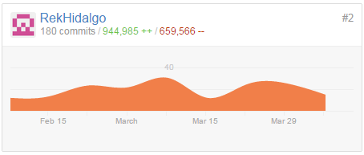
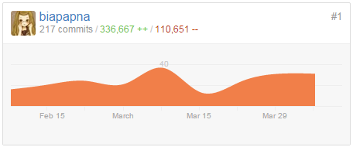
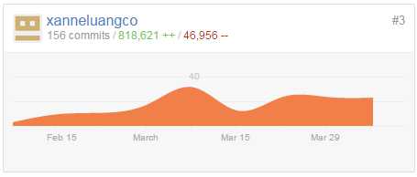
Member Contributions

Slide 9

Arianne Papna
Modules:
Visa Appointment Module
Others:
Database Design
System UI Design
Extension / Widget installation

Slide 10

Erika Hidalgo
Modules:
Maintenance Modules
Others:
Email Configuration
User Management
Tech Support

Slide 11

Roxanne Luangco
Modules:
Travel Arrangement Module
Others:
Project Documentation
Error / Bug Handling

Slide 12
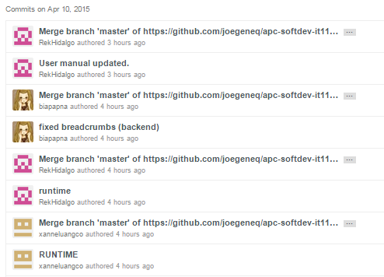
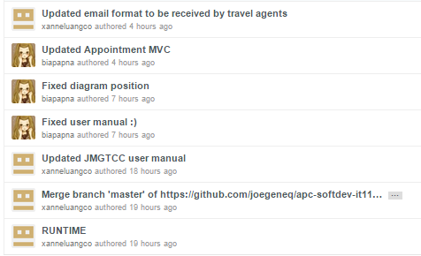
Recent Commits

Slide 13
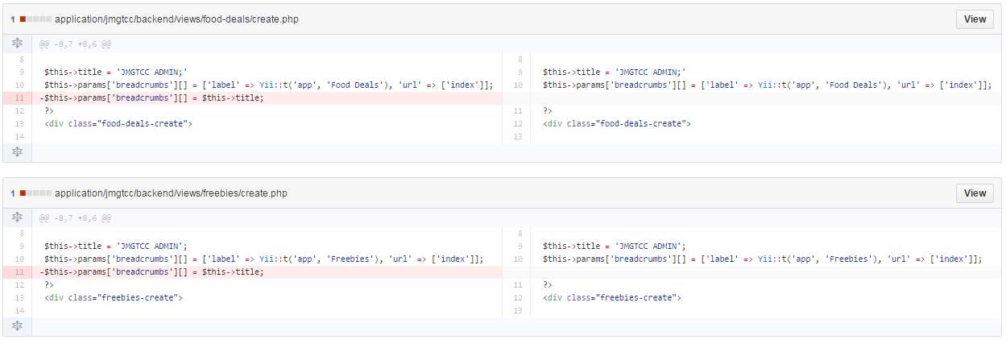
Commit Difference
Arianne Papna

Slide 14
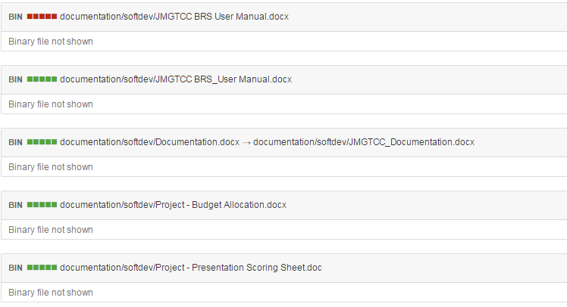
Commit Difference
Erika Hidalgo

Slide 15
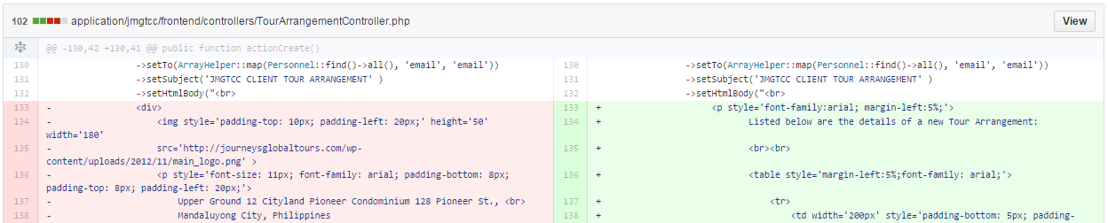
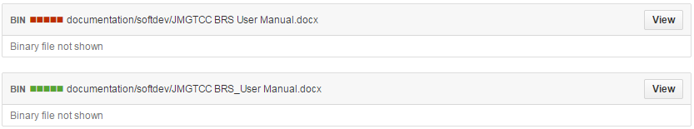
Commit Difference
Roxanne Luangco

Slide 16
Current Status of the Project
95% Complete
Remaining Tasks
- Sending to various emails (if funded)
Client Feedback
- The client was happy with the system and JMGTCC is planning to deploy it and merge it with their current website.

Slide 17
Next Steps to Accomplish
Final Presentation schedule
- April 14, 2015 (Tuesday)
Future plan for the project (If any)
- Licensed tech. support system
- Incorporate major Security measures

Slide 18
Demo

